Slide 1

IP and Domain Threat Intel
Hands-On Enrichment of IPs and Domains Using Open Source Intelligence
WCC Cybersecurity Club Officers Training 2025

Slide 2
Learning Objectives
By the end of this lab, you will be able to:
Understand IP and domain threat intelligence in a SOC context
Geolocate IPs and interpret their ASNs
Detect red-flag infrastructure via Shodan/Censys service banners
Assess reputation using open-source tools
Enrich domains with WHOIS age, DNS records, and certificate transparency

Slide 3
Security teams usually follow a basic process when investigating alerts: Verify → Enrich → Decide
Verify means checking if the alert is real. Enrich means gathering more information to understand it better. Decide means choosing what action to take.
But when the alert is just an IP address or domain name, enrichment works differently. Instead of looking at file hashes or user behavior, analysts pivot to:
🌍 Geolocation – Where in the world is the IP located? Is it coming from a risky region?
🏢 ASN (Autonomous System Number) – Who owns the IP? Is it a known hosting provider or a suspicious network?
🔎 Open-service footprints – Using tools like Shodan or Censys to see what services are running on the IP (e.g., exposed login pages, remote access ports)
🧠 Passive DNS – Looking at the domain’s history: what IPs it’s pointed to, how often it changes, and whether it’s linked to malicious activity
These clues help analysts decide: 🟢 Is this just normal traffic to a trusted service? 🔴 Or is it a sign of a threat—like a command-and-control beacon or attacker infrastructure?

Slide 4
Scenario
It is Wednesday morning. The SOC has flagged two suspicious domains in phishing emails and three IP addresses in outbound proxy logs. You are tasked with triaging all seven artefacts, enriching them with context, and recommending actions with expiry.
advanced-ip-sccanner[.]com
166[.]1[.]160[.]118
64[.]31[.]63[.]194
69[.]197[.]185[.]26
85[.]188[.]1[.]133

Slide 5
Core DNS Records for Triage NsLookup
When you enrich a domain, these are the records that matter most
A / AAAA Records: Map the domain to IPv4 and IPv6 addresses. If you see several A records that hop between different networks, raise suspicion of rapid rotation. In practice, copy the A record from nslookup.io or dnschecker.org and follow with pasting the IP into VirusTotal for context.
NS Records: Identify the nameservers controlling the domain. Unusual or recently changed NS entries can mark fresh set up. Note the provider name rather than chasing low-level details.
MX Records: Define which servers handle email. Attackers may configure MX records to deliver phishing campaigns directly. If the alert relates to web browsing, just record whether MX exists.
TXT Records: Store SPF and DKIM rules or verification tags. Poorly configured or absent SPF can increase risk in mail cases.
SOA Record: Points to the zone's primary authority and often includes contact information. It will be worth noting the primary host and serial, which will support a basic ownership picture.
TTL (Time To Live): Tells resolvers how long to cache answers. Very low TTLs, seconds or minutes, can point to frequent changes, and should be treated as clues.

Slide 6
Attack Techniques Using DNS
SOC Analyst Workflow
Fast Flux Hosting: Adversaries rotate many IPs quickly with short cache times to avoid simple blocks. We need to record and escalate when we identify a domain that resolves to changing IPs within a short period and across different providers.
CDN Abuse: Legitimate CDNs like Cloudflare or Akamai change IPs too, but done within their ASN ecosystem. If the A record points to a major CDN and other values are normal, take note and carry reputation and ownership checks,
Typosquatting: Domains like paypa1[.]com or micros0ft[.]net trick users visually. If a name looks like a brand clone, treat it as high risk and escalate it.
IDN (Internationalised Domain Names): Attackers exploit Unicode, creating look-alike domains. Decode Punycode, for example xn--ppaypal-3ya[.]com, and compare to known brands using simple online decoder.
At this stage, our workflow could look as follows. Keep in mind, depending on your organization, your procedure my vary.
Snapshot Current DNS: Capture A, NS, MX, TXT, SOA, and TTL values for the domain in question using a single page view and simple.
Basic Ownership Check: Use WHOIS to note registrat, creation date and contact pattern, which supports a light ownership picture of the ticket.
Interpret Patterns: Assess whether the DNS behaviour aligns with benign CDN activity or indicates malicious throwaway domain, noting down the details of the changing IPs.
Log Evidence: Save screenshots or JSON extracts DNS and reputation pages to the case file for audit and escalation.
Recommend Action: Based on findings, advise blocking if high risk, monitor if suspicious but inconclusive, or close if determined benign

Slide 7
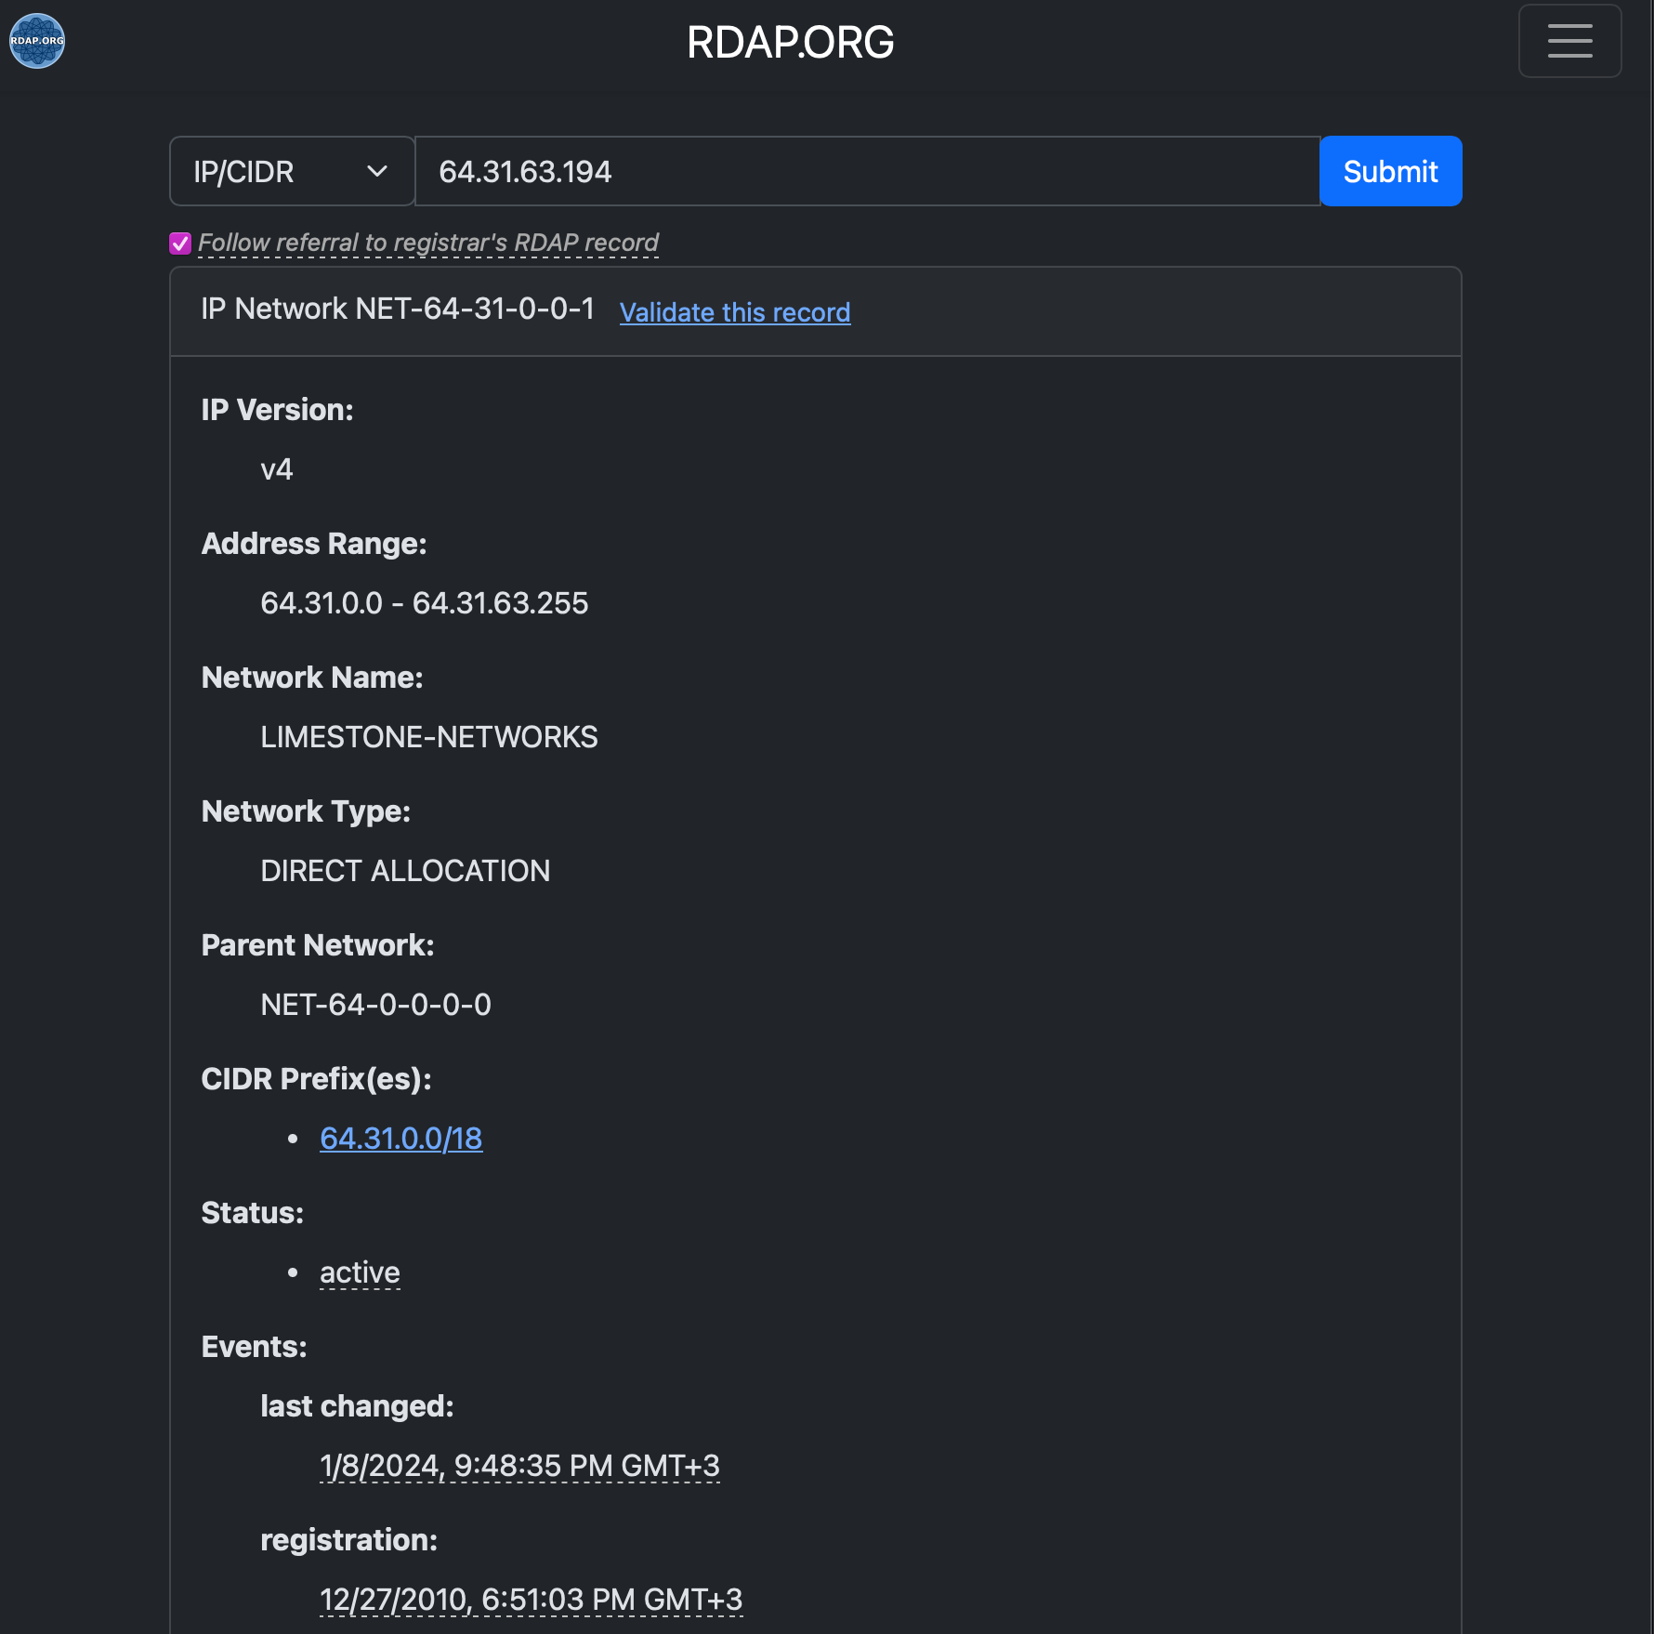
IP Enrichment Within the SOC
When we talk about enrichment, we’re really talking about adding context to an IP address—who owns it, where it’s located, what network it belongs to, and what services it’s running. That way, when we make a decision, it’s not just a guess—it’s backed by evidence.
The Role of RDAP
The Registration Data Access Protocol (RDAP) is the authoritative source for IP ownership. RDAP data is maintained by Regional Internet Registries (RIRs) such as RIPE NCC, ARIN, and APNIC. It tells us precisely who has been provided with the netblock.
Using RDAP, we can get:
NetRange: The range of addresses delegated.
Organisation: The registered holder (e.g., Amazon, Microsoft, etc..).
Remarks: Often include whether the block is used for hosting, broadband, or mobile.
Abuse Contact: The official mailbox for incident reporting.

Slide 8
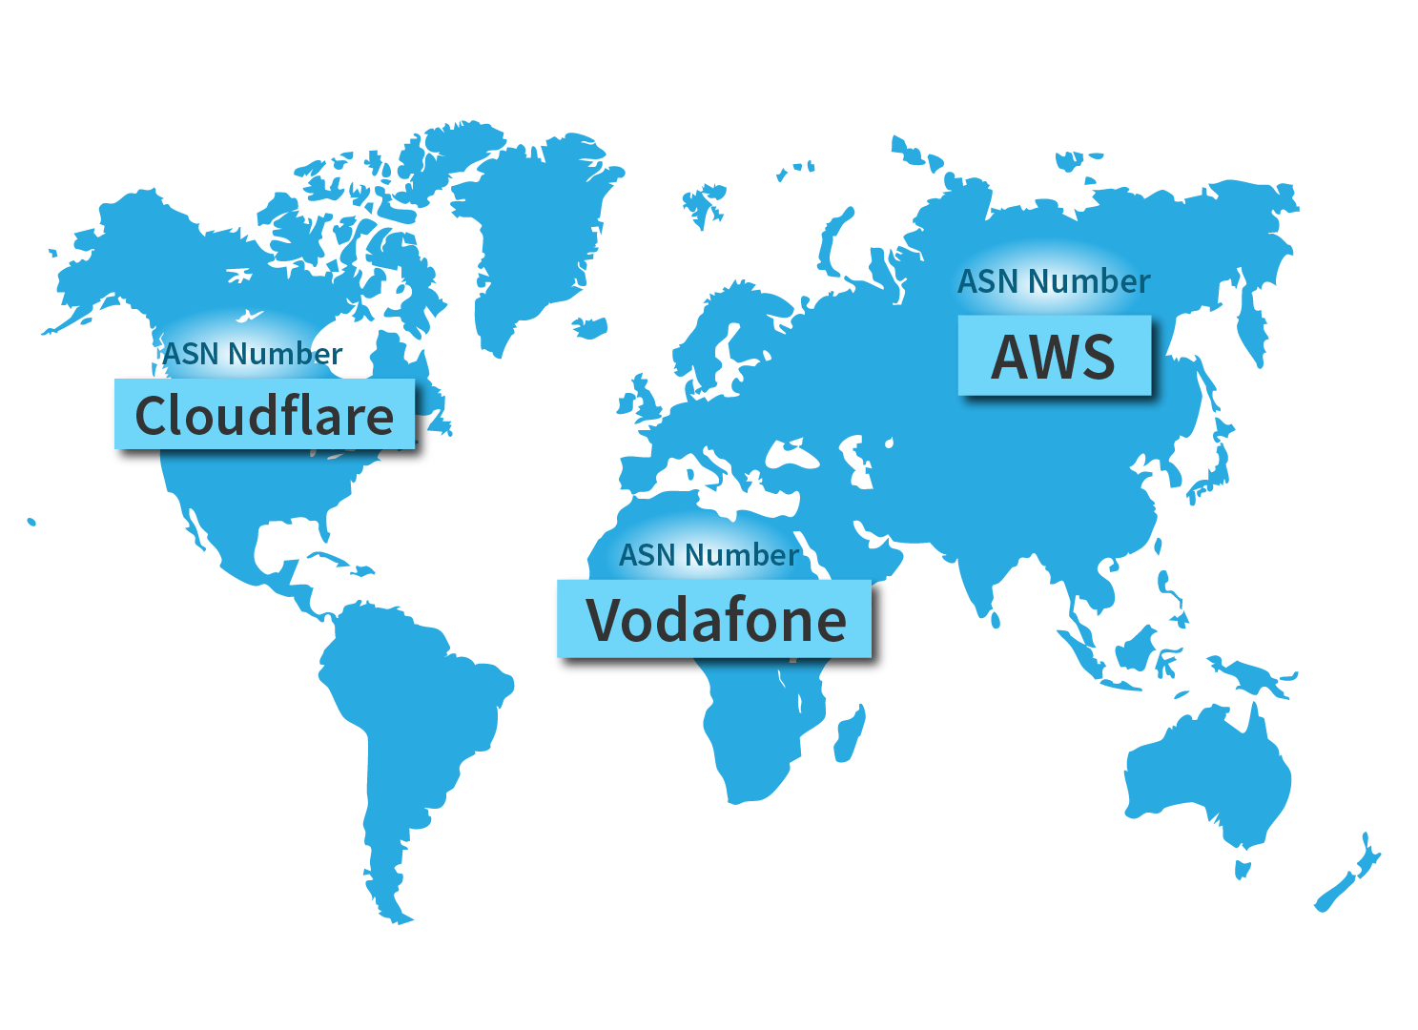
Autonomous Systems and Heuristics
An Autonomous System (AS) is a collection of IP prefixes under a single organisation’s control. Each AS is assigned a unique 16 or 32-bit number (ASN), only required for external communications. Looking at the ASN helps analysts assess the likely role of an IP.
Hosting ASNs: Many small netblocks, often with diverse tenants. Suspicious domains are frequently hosted here.
Residential ISPs: These have huge ranges covering millions of users. Alerts on these may indicate compromised home routers or consumer devices.
Cloud/CDN ASNs: Global anycast, dozens of prefixes, shared edges. Blocking whole ranges here causes collateral damage.
Examples of ASN classification:
AS32934 - Facebook/Meta: Traffic from here is based on the social media infrastructure. Malicious use may likely indicate an account issue, and not malicious hosting.
AS16509 - Amazon AWS: This would cover a massive cloud space, and attackers would often abuse it for short-lived servers. Blocking the entire ASN would be catastrophic, so we scope to the FQDN or narrow the CIDR.
AS124888 - Vodafone: This covers an ISP. Malicious activity would likely be from a compromised customer device.

Slide 9
SOC Analyst Workflow
Start with RDAP: Confirm netrange, org, ASN, and abuse contacts.
Add ASN Context: Check bgpview.io or ipinfo.io for ASN details and role.
Check Geolocation: Capture country from at least two sources. Record mismatches.
Look for rDNS Patterns: Reverse DNS can hint at hosting type (e.g., *[.]btcentralplus[.]com = UK broadband). Do not base decisions solely on rDNS.
Consult Internal Logs: Has this IP appeared in the last 30 days? If yes, in what context?
Classify Role: Hosting, residential, CDN, or cloud. Record reasoning.
Plan Outreach: If confirmed malicious and in a cooperative ASN, prepare a report for the abuse contact.

Slide 10
Service Exposure
Services and Certificates
Checking where an IP address or domain is located can give us clues about what it's meant to do. When we see what services are exposed, it helps us understand the system’s purpose—and how much damage could happen if those services were misused. For example, if an IP has Remote Desktop Protocol (RDP) open on port 3389, it could be an easy target for brute-force attacks
Shodan Reconnaissance – We can view Open Ports and Service Banners
TLS Certificates as Infrastructure Clues
We can use Crt.sh to enrich TLS Certificate Information. Key Fields to look out for:
Issuer: This field provides details on who signed the certificate. For example, Let's Encrypt is a common but neutral vendor. A self-signed certificate may be a sign of a hastily deployed system.
Validity Period: Short-lived certificates—typically valid for up to 90 days—are pretty common. But if you notice a sudden spike in certificates being reissued, that’s a red flag. It could point to phishing infrastructure
Subject Alternative Names: This provides details on the domains covered by the certificate.
Tools like Censys.io helps analysts dig deeper by finding systems that share the same certificate or spotting clusters of similar domains using parts of the certificate’s subject.
Notes:
Open Ports are like the system’s first handshake with the outside world—they’re the initial signs that something is accessible. Service Banners give us helpful clues about what kind of server or framework is running behind the scenes. They often include software versions or even cookies in RDP or HTTP banners, which can reveal unique markers left by the system’s operator

Slide 11
SOC Analyst Workflow
Check Shodan/Censys banners: Identify exposed services and possible misconfigurations.
Review TLS certificates: Ensure to record issuer, SANs, and validity period.
Look for anomalies: Instances of multiple SANs, brand look-alikes or sudden bursts of issuance.
Pivot: Utilise the certificate or banner artefacts to uncover related infrastructure.
Assess blast radius:
RDP/SSH on residential ASN → shows a likelihood of a compromised endpoint.
TLS with many unrelated SANs on CDN ASN → shared infrastructure, avoid IP block.
Self-signed TLS on small ranges → shows likelihood of attacker panels or proxies.

Slide 12
Reputation Check At this stage of enrichment, we’ve uncovered two key pieces of intelligence: who owns the IP or domain, and what services it’s exposing.
Reputation Services
VirusTotal
CiscoTalos - provides frequently updated web and email reputation scores and category labels.
IP2Proxy - is use for labelling VPN, proxy, and Tor exit nodes.
WaybackMachine – can be used to view reveal historical website content.

Slide 13
SOC Analyst Workflow
Check VirusTotal: Record detection ratio, First Seen, Last Seen, and any community notes.
Check Cisco Talos: Record reputation score and category, noting any changes in the last 30 days.
Check IP2Proxy: Flag if VPN/proxy/Tor; adjust severity accordingly.
Check Passive DNS: Record First Seen, Last Seen, number of IPs in the last 7 days, and ASN spread. (Censys)
Check CT Logs: Note certificate bursts, suspicious SANs. (Censys)
Cross-Reference with Wayback: Identify content shifts (benign → phishing).
Decision: Block, monitor, or close, with expiry tied to observed activity.

Slide 14

Questions?

Slide 15
Challenge
It’s 09:10 on a Monday. Over the weekend, Finance reported a burst of “account verification” emails that looked unusually polished. Your secure email gateway caught a subset; one clicked sample was redirected tosantagift[.]shop.
At the same time, your EDR shows workstations briefly beaconing to 170[.]130[.]202[.]134.
What is the RIR associated with 170[.]130[.]202[.]134?
What ASN is the IP connected with?
Identify the number of NS records for the domain santagift[.]shop.
Which NS is identified as the Start of Authority (SOA) for the domain?
When was the domain registered?

